Slide 1


Final Project v.2 Information
DATA ANALYSIS AND VISUALIZATION
Mirko Rossi

Slide 2
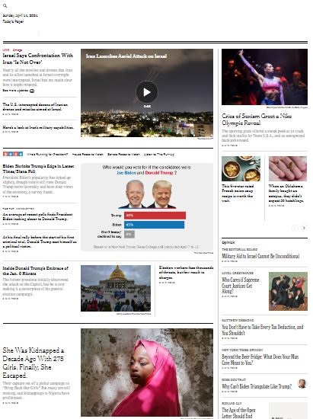
Introduction
The European Times
The final project consists of creating a dashboard that includes a strategy proposal and the creation of user personas for a fictitious online general information newspaper: The European Times.

Slide 3
Introduction
The European Times
"The European Times" is a small media startup launched in 2021 that aims to give a voice to emerging and talented journalists. The project consists of a website and various social media channels used to share published articles.
"The European Times" was born with generalist ambitions, to cover topics ranging from economy to art, producing articles in multiple languages to reach multiple international markets and aiming at multi-platform uses.

Slide 4
Introduction
The European Times
The publisher aims to market the newspaper as a reference for a polyglot niche.
After a year, the publisher decides to hire a Data Analyst to analyze the performance of the website and produce, together with marketing, a strategy for the year 2022.
The Data Analyst can query the database in which accesses to the site by registered users are recorded.

Slide 5






Introduction
I divided the project into four phases:
EDA (Exploratory Data Analysis) with Python
Data Visualization
Creation of the User Persona
Strategy proposal
In this project, I used the Python language for EDA and Tableau software for Data Visualization.

Slide 6
Exploratory Data Analysis

Slide 7
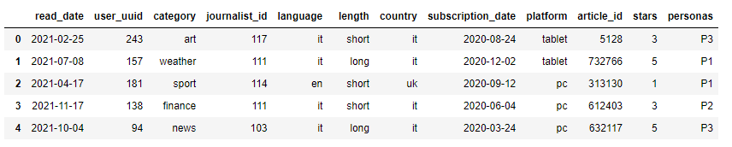
Dataset Study - head method

Slide 8
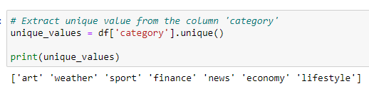







Categories
Weather
News
Sport
Art
Economy
Lifestyle
Finance

Slide 9
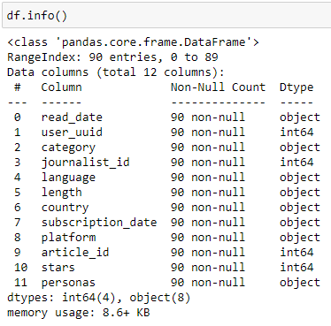
Dataset study - head and info methods
The dataset is already clean and easy to understand.
It is made up of 9 fields that describe each reading that took place on the site.
There are 90 records and there are no null values.

Slide 10
Dataset study - dataset fields
Column | Description
read_date | The date the user read the article
user_uuid | User identifier
category | News category
journalist_id | Article author identifier
language | Article language
length | Item length
country | User nationality
subscription_date | Day the user signed up
platformer | Platform from which the article was read
article_id | Item identifier
stars | Average stars assigned to the article (from 1 to 5)

Slide 11

Statistics
Based on the data provided, the site was used for only 80 days with an average of 1.12 articles read per day.
Just 53 users registered on the site with an average of 1.70 articles read per user.
There are 22 journalists working for the site with an average of 4 articles written per journalist.

Slide 12
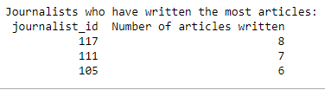


Statistics
The most productive journalist is number 117 and, by sorting the articles by category, each article was read only once.
February and October are the months with more reads.

Slide 13
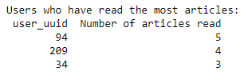

Statistics
The most loyal user is number 94, who has read 5 articles.
Sorting the individual articles by number of readings also shows that each article has been read once.

Slide 14
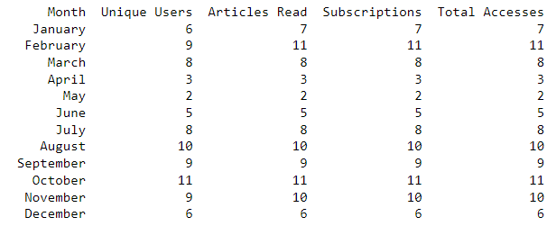
Statistics
The most accessed month in 2021 is February, in which 11 articles were read, the highest number.
The month with the least number of accesses in 2021 is May, with 2 accesses and 2 articles read.
The chart could be simplified to a two-column chart since only subscribed users are recorded and every access to the website is related only to the opening of an article page.

Slide 15
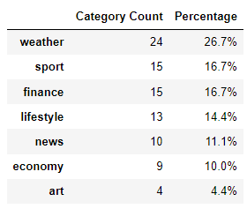
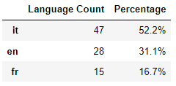
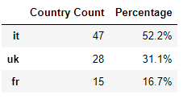
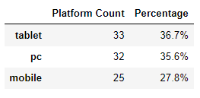
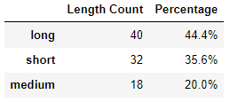
Distribution of values
The values of the analysed fields describe a prevalence of interest in articles in the weather category in Italian and read by Italian users.
The most-read articles are long and viewed on tablets and PCs.

Slide 16
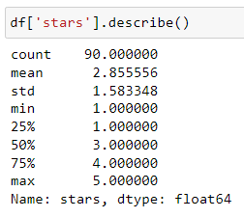
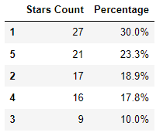
Distribution of values
The average rating is 2.85 stars out of 5 but almost 50% of the reviews are below average.

Slide 17
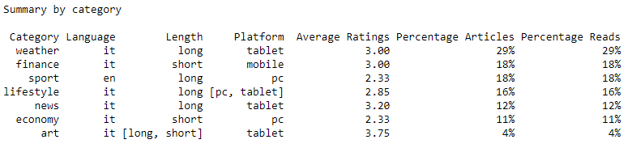
Summary by category
Since each article has been read only once, “Percentage Articles” and “Percentage Reads” show the same percentages.

Slide 18
Data Visualization

Slide 19

KPI - Key Performance Indicator
The data visualization in Tableau dashboards summarises in graphical form the results already obtained with Python.
The KPIs (Key Performance Indicators) used are the number of users, the number of articles read and the average score.
KPI

Slide 20
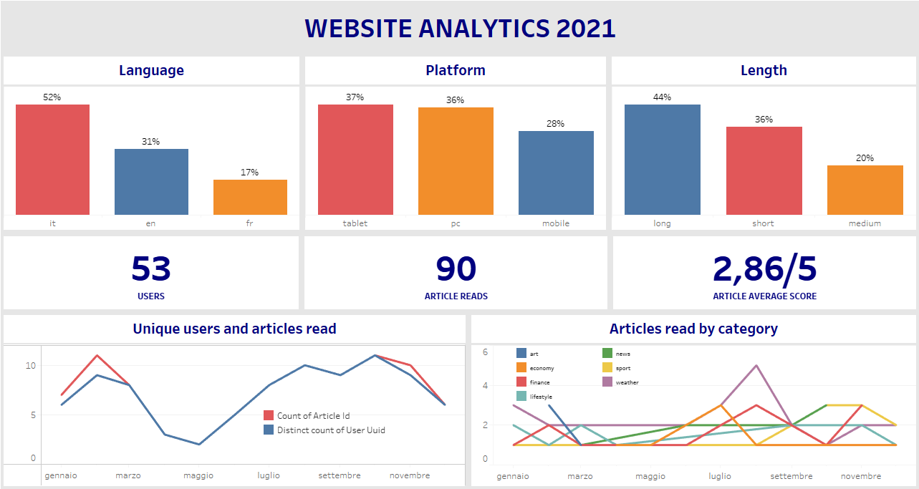

Slide 21
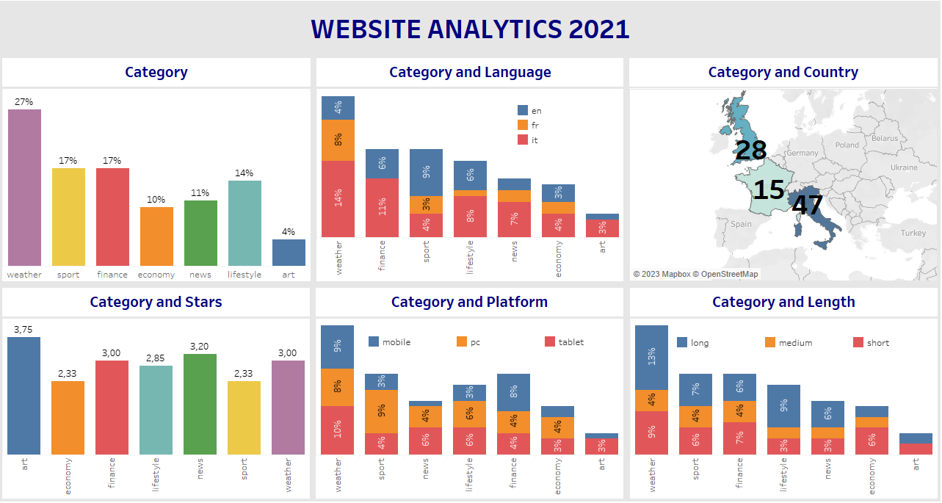

Slide 22
Creation of the User Persona

Slide 23
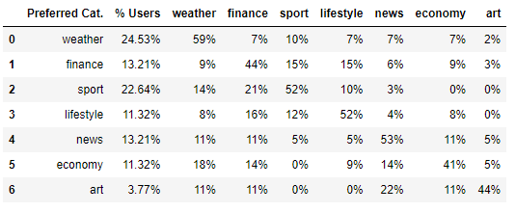
User clustering
To create the User Personas, I chose to use a data-driven approach with Python.
I calculated the percentages of users who have a preference for each category and, subsequently, their preference for all the others.

Slide 24
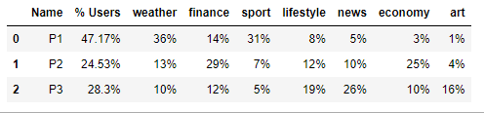
User clustering
Below I have selected some reasonably coherent clusters:
weather and sports
economy and finance
lifestyle, art and news

Slide 25
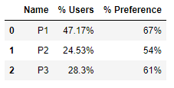
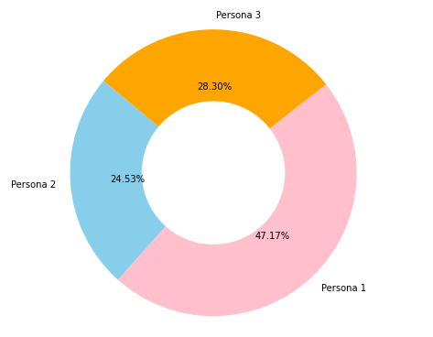
User clustering
Finally, I calculated the average approval percentages after the merger.
I carried out the study of the profiles and the creation of the dashboards with Tableau.

Slide 26
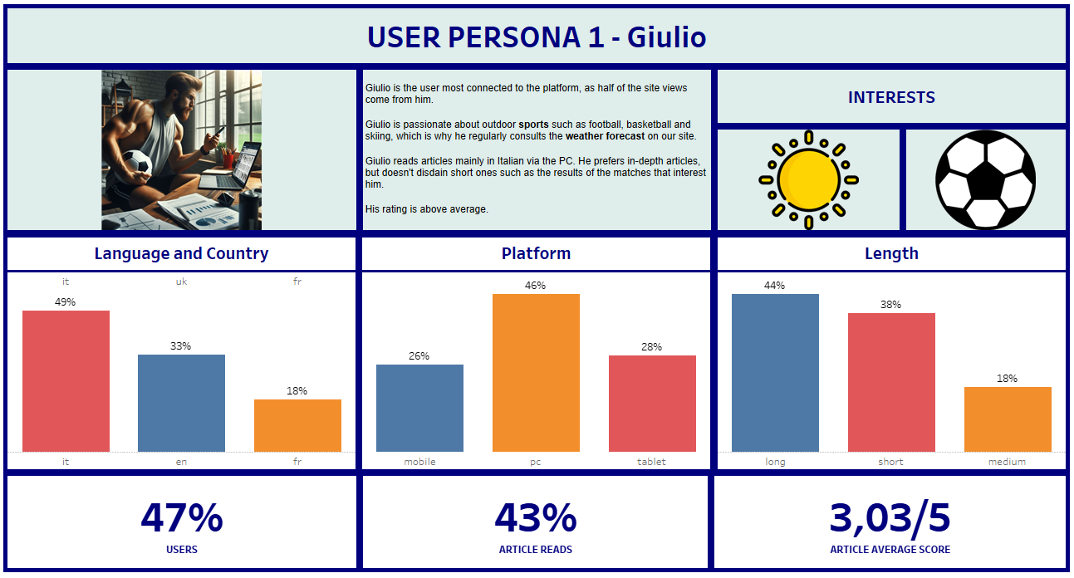

Slide 27
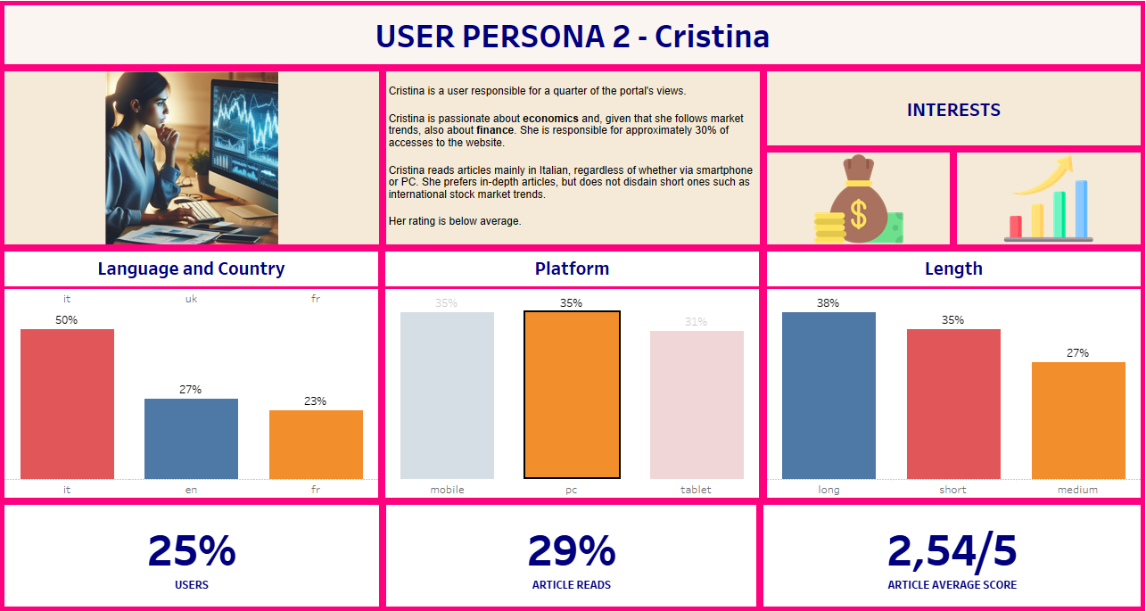

Slide 28
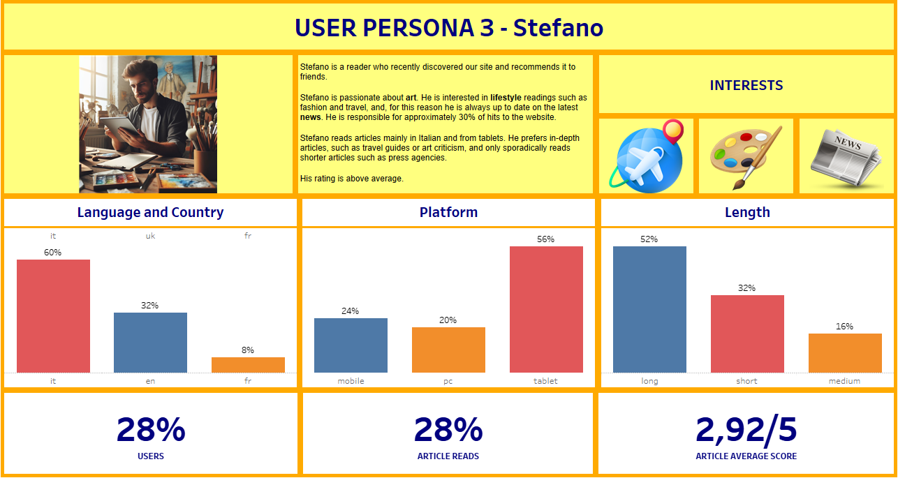

Slide 29
Strategy proposal

Slide 30
Strategy Proposal
To develop a complete strategy proposal, you should at least know the market and competitor data of the website.
In absence of this information one can apply general principles of startups: focus the investments on what gives you more and faster results.

Slide 31
Strategy Proposal
For organic growth of the various sections of the site, it is necessary to invest in art articles, which represent just 4% of the total articles and in general in articles in French, whose percentage fraction is under 20%.
This objective is achievable by increasing collaborations with journalists specialized in art and journalists of all categories who write in French.

Slide 32
Strategy Proposal
It would be useful to increase the advertisement in May, which seems like the month of lower accesses to the website.
It’s of course important to obtain data of the market of online newspapers.

Slide 33

Strategy Proposal - User Persona 1
Regarding Giulio, user persona 1, the participation of this user on our site must be consolidated by inserting content in line with the current level of quality of weather and sport articles, which Giulio appreciates.
It is possible to enhance his value during the sale of advertising spaces for use on PCs.

Slide 34

Strategy Proposal - User Persona 2
Regarding Cristina, user persona 2, we need to increase the share of this user and invest resources to produce higher quality content of economy and finance.
By increasing the percentage of this user, it will be possible to enhance her value during the sale of advertising spaces for use on PCs, tablets and smartphones.

Slide 35

Strategy Proposal - User Persona 3
Regarding Stefano, user persona 3, we need to increase the share of this user and invest resources to produce content in French, which is present in less than 10% of the articles he reads.
By increasing the percentage relating to this user, it will be possible to enhance his value during the sale of advertising spaces for use, especially on tablets.

Slide 36
Links
The Jupyter notebook and Tableau dashboards from this project are publicly available.

